Slide 1
Introduction to Phage Commander
Phage Commander is an application for identifying genes in phage genomes using multiple gene identification programs
Phage Commander runs a phage’s DNA sequence through gene identification tools and outputs a list of potential genes. These tools include:
RAST, Prodigal, Metagene, Glimmer, Genemark, host-trained Genemark.hmm, Genemark S, Genemark S2, Genemark Heuristic, and Aragorn (for tRNA genes)
Phage Commander’s output can be exported in Excel format (.xlsx) or NCBI GenBank format (.gb) for upload to GenBank or further processing in DNA Master
A paper describing Phage Commander in detail is here: https://www.liebertpub.com/doi/full/10.1089/phage.2020.0044

Slide 2
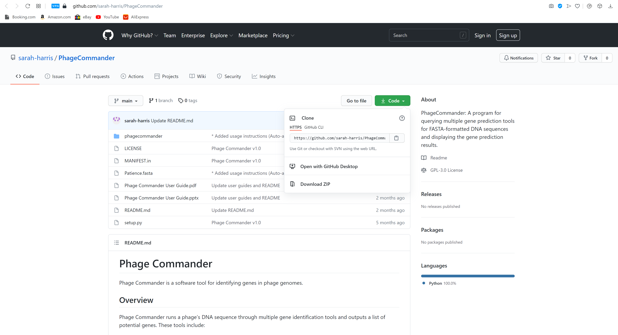
Installing Phage Commander (Windows and Mac)
Download Phage Commander from GitHub repository: https://github.com/sarah-harris/PhageCommander
Click the green “Code” button
Click “Download Zip”

Slide 3
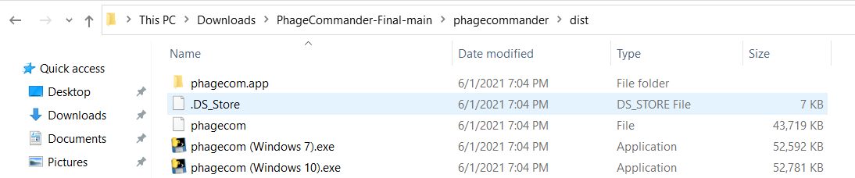
Installing Phage Commander (Windows and Mac)
Go to your downloads folder and unzip Phage Commander with your favorite unzip program (I like 7-zip https://www.7-zip.org/)
After unzipping, move the “PhageCommander-Final-main” folder to your desired location, open it, click on the “phagecommander” subfolder, and then the “dist” subfolder, and then the .exe file to run

Slide 4
Installing Phage Commander (Linux)
Open a shell. Navigate to folder where you have downloaded phagecommander. Type py phagecom.py. If you need to install any of the supporting packages, first type: ‘pip install .’ (in the PhageCommander-master directory – the directory that contains setup.py)

Slide 5
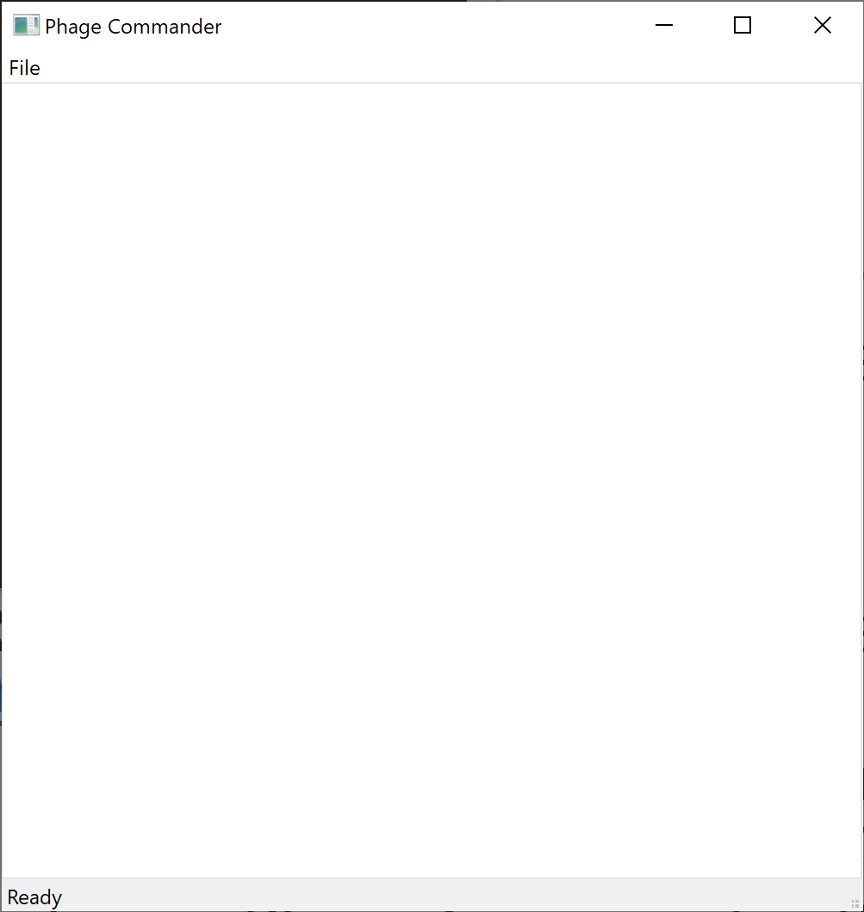
Running Phage Commander
When you first run Phage Commander, a blank Phage Commander window will appear

Slide 6
How to use Phage Commander
In the Phage Commander window, click on the File menu, and select New
The “Select Gene Identification Tools” dialog will open (see next slide). Select which tools you would like to use
To use RAST, you will need to create a login and password at https://rast.nmpdr.org (free and easy)
If using host-trained GeneMark.hmm you will need to select your phage’s bacterial host from the drop down menu under Species
Press Open and select your phage’s fasta file - an example fasta file is included in the GitHub repository: Patience.fasta
Press Run Phage Commander to run Phage Commander. Phage Commander will now run the phage genome through the selected tools – this may take several minutes
When Phage Commander completes, press OK

Slide 7
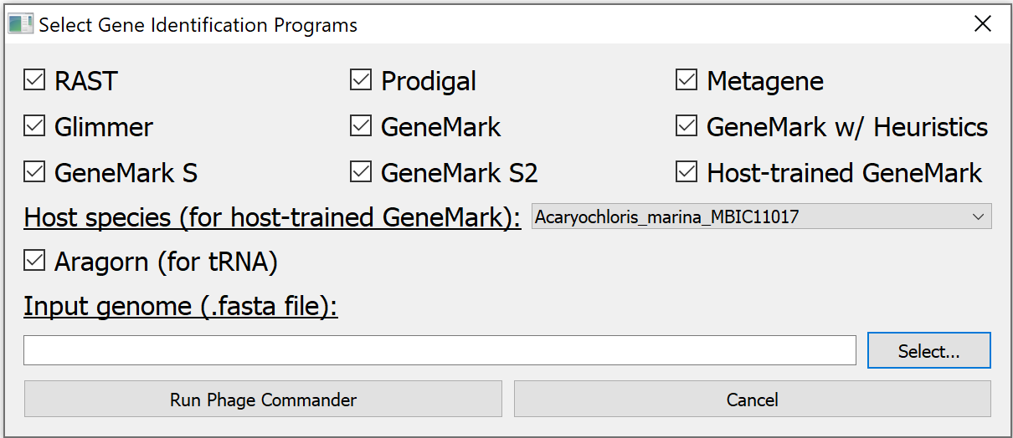
Select Gene Identification Tools
Check the boxes of the tools you want to use
If using RAST, you will need to create a login and password on the RAST website
(rast.nmpdr.org/)and enter it when prompted by Phage Commander
Select host from drop down menu if using Host-trained GeneMark
Select genome (fasta file)
Run Phage Commander

Slide 8
In the Event of an Error
If Phage Commander runs successfully, you will see a window saying “Done! Query Successful”
Press OK and you will see the Phage Commander output in the form of a spreadsheet (expand the window)
If phage commander encounters an error, the error message will display which program is causing the error (e.g. Glimmer, Aragorn, GMS2, etc.)
To work around this, re-run Phage Commander without including the program causing the error

Slide 9
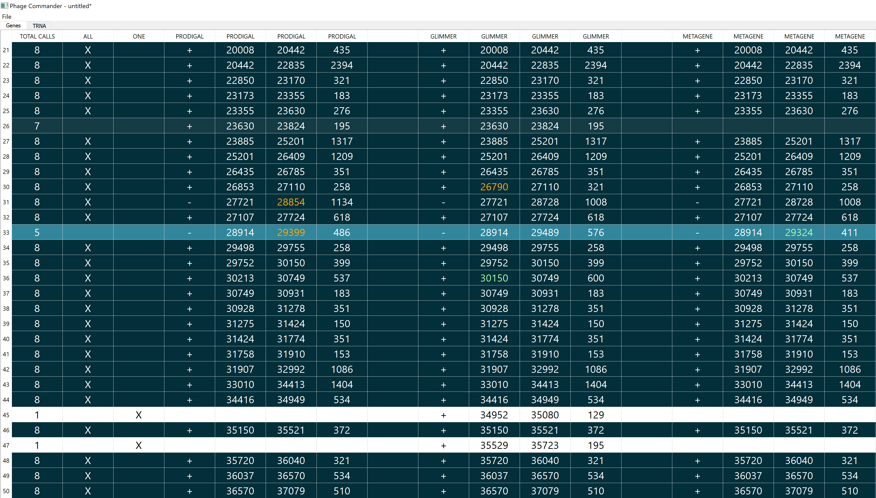
“Total Calls”
is the number of programs identifying a gene
“All” column shows which genes are identified by
all programs used
Genes identified by Prodigal
Genes identified by Glimmer
Genes identified
by MetaGene
Each row
is a gene
“One” column shows which genes are identified by only one program

Slide 10
Row shading is proportional to how many programs identify a gene (darker = more programs, white = only one program)
DNA strand (+ or -)
Gene start (stop if strand “-”)
Gene stop (start if strand is “-”)
Gene length

Slide 11
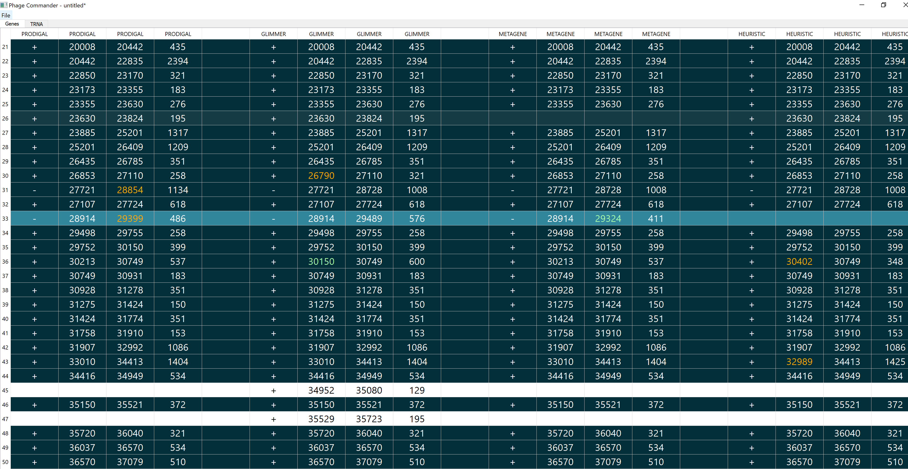
Gene starts chosen by the majority of programs shown in black (or white) font
Gene starts chosen by a minority of programs are shown in different color font (orange, green, yellow, violet)

Slide 12
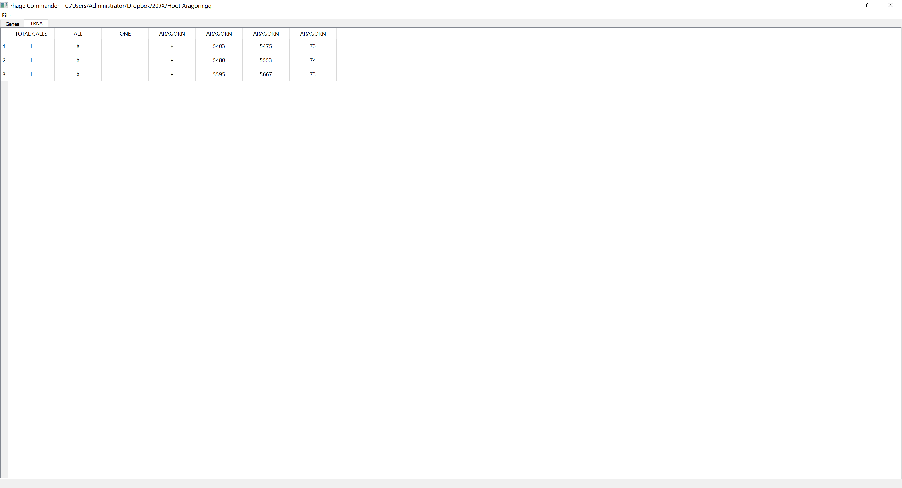
tRNA genes
Identified by Aragorn in “TRNA” tab
Total calls is always 1 since Aragorn is the only program for identifying tRNA genes

Slide 13
Saving your work
Phage Commander output can be saved as .gq file for later use
File menu → Save As
File menu → Load (for loading .gq files)

Slide 14
Exporting Phage Commander Results
To export as excel spreadsheet, select:
File → Export → Excel
To export as GenBank (.gb) format file, select:
File → Export → GenBank

Slide 15
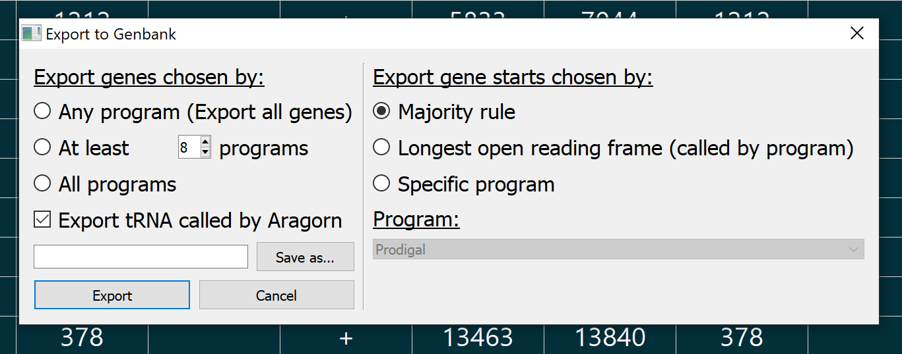
Exporting Phage Commander results in .gb format
Export genes identified by
at least one program (i.e. all genes, least stringent)
Export gene starts chosen by majority rule
Export genes identified by at least the set number of programs
Export gene starts that generate the longest open reading frame (but are chosen by at least 1 program)
Export only those genes identified by all programs (most stringent)
Export gene starts chosen by a specific program (e.g. Prodigal – if program does not call a particular gene, default to majority rule)
Press “Save as” and enter desired filename
Finally, press “Export”

Slide 16
Export Gene settings
“Any program” will export all genes identified by at least one program – this is the least conservative setting (I use this one most of the time)
“At least” will export those genes identified by a number of programs greater than the threshold (e.g. genes identified by 2 or more programs. Use “0” as the threshold will export all genes identified)
“All programs” will export only those genes chosen by all programs used (this is the most conservative setting, will export the fewest genes)
“Export tRNAs called by Aragorn” will export the tRNA genes identified by Aragorn

Slide 17
Which gene starts to export?
“Majority rule” – for each gene, export the start chosen by the majority of programs (in the event of tie, export the start that produces the longer of the two reading frames)
“Longest open reading frame” – for each gene, export the start that produces the longest possible reading frame (provided it is chosen by at least one program)
“Specific program” – export the gene starts chosen by a particular program (in the event that a gene is not identified by the chosen program, default to majority rule)

Slide 18
Further Processing
The .gb file is properly formatted for direct upload to NCBI GenBank if that is desired
Alternatively, if further processing of the results is desired (e.g. adding/removing genes, modifying gene starts, or assigning putative function), the .gb can be imported into DNA Master (https://phagesdb.org/DNAMaster/) for further processing
In DNA Master, go to the “File” menu, select “Open”, and select “GenBank formatted file”. In the dialog that appears, navigate to the folder you stored your .gb file from Phage Commaner (make sure you select “GenBank Files (*.GB)”) and simply open it

